Slide 1
Mingo County Schools Mathematics
2018-2019

Slide 3
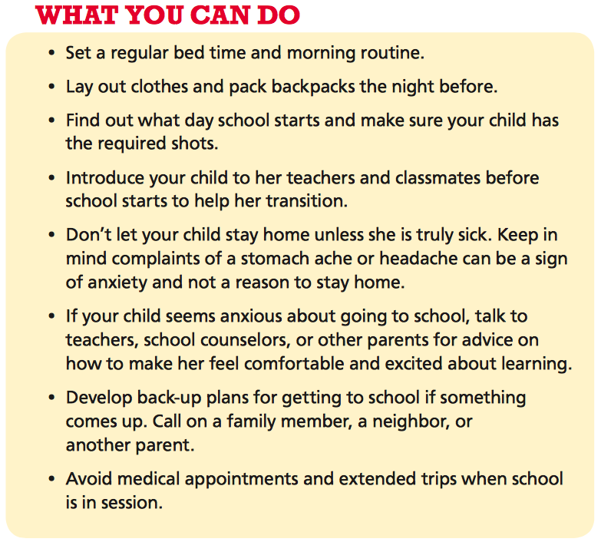
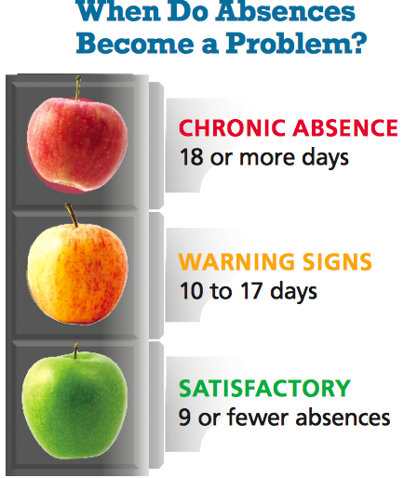

Slide 4
Instill a Love of Math!!
Make math REAL and meaningful by pointing it out in the world around you
Newspaper: statistics (especially sports!), graphs, charts, surveys
Banking: interest rates, stock market, paying bills
Shopping: unit rate, sales tax, coupons, sale price, better deal
Cooking: measuring, doubling, halving, time
Building: measuring, geometry, cost of materials
Estimating: EVERYTHING
Playing games: board games, card games, puzzles, logic problems, and brain teasers
AVOID TALKING NEGATIVELY ABOUT MATH

Slide 5
Wendy’s Soda Machine

Slide 6
The Coke Combinations Alone…

Slide 7
Grades K-8 Pearson enVisionmath 2.0

Slide 10
Pearson enVisionmath2.0

Slide 11
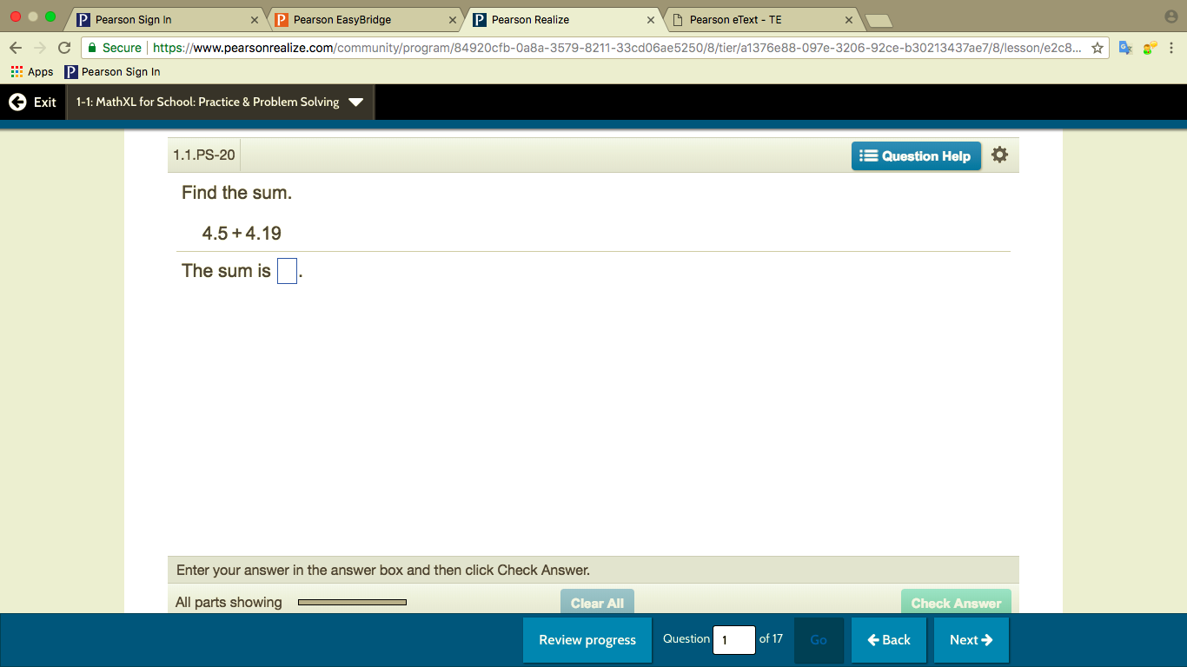
Practice Buddy Math XL for School Grades 3-5 Grades 6-8

Slide 12
Adaptive Homework & Practice Grades 3-8
3-8

Slide 13
On-line video tutorial: Bounce Pages app

